Slide 1
keepside
01
Family stories,
kept close
Shared family stories for responsible dementia support
Hamza Munshi
Greenwich Enterprise Challenge 2026–27
Concept and evaluation plan
Notes:
Keepside is a concept for a dementia-support service built on a private family archive of photographs, original recordings and their context. The funded work is an accessible supported experience, secure pilot infrastructure, co-design with families affected by dementia and practitioners, and an initial evaluation of usefulness, comfort and interaction. Hamza brings established experience in websites and business automation. The family archive is the technical foundation, rather than the whole funding case. Hamza plans product development after funding as his project sequence. No validated benefit, customer traction, clinical efficacy or guaranteed recognition is established.

Slide 2
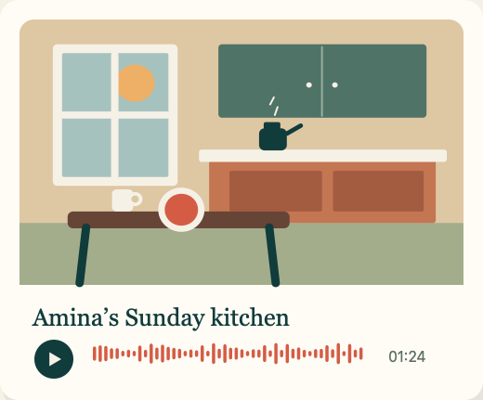
keepside
02
A shared moment, at the person’s pace
A familiar story.
Room to choose.
Imagine Amina, who lives with dementia,
and Sam choosing a family photo
to view and listen to together.
Illustrative example. Sam and Amina are fictional.
Concept and evaluation plan
Notes:
Amina and Sam are fictional. This is an illustrative situation to investigate, not a real testimonial, a diagnosis of a real person, a claimed outcome or Hamza’s personal story. The intended service helps families offer a photograph and its original voice context at the person’s pace. Whether that feels useful or comfortable, or supports interaction, must be explored with the person and those supporting them. Recognition and enjoyment are never guaranteed. Participation, listening, skipping and stopping remain choices.

Slide 3
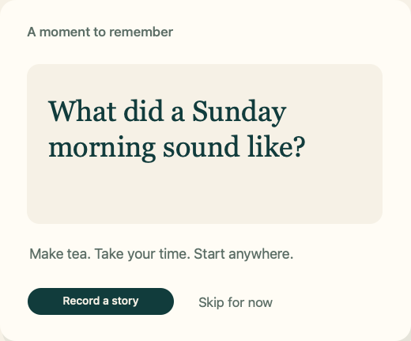
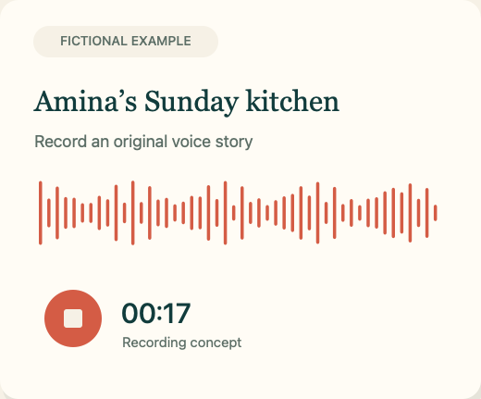
keepside
03
Family Story Starter
Family relationship map
Fictional family. Viewer: Dad
Dad
Maya
Ben
Leila
Ben: Your son
Family-reviewed relationship
Chosen photos + optional story
Choose a few photos
Optional original voice
Choose Ben. See “Your son”
A family-reviewed relationship leads to chosen photos and optional original voice.
Fictional example. Five photos is a proposed starting scope.
Concept and evaluation plan
Notes:
Family Story Starter supplies a small collection for the first dementia-support pilot. One organiser helps a willing storyteller connect up to five chosen photos with up to five optional short original recordings and clear context, with permission. This is a scope hypothesis, not a proven need, minimum obligation or completion guarantee. The service ambition adds accessible supported viewing, carefully controlled access, secure storage and evaluation with families affected by dementia. Families and practitioners co-design the pace, controls, prompts and support needed. These concept-film frames show only the archive foundation, not a tested supported view. The existing 78-second film remains an earlier archive-focused concept. Its final scenes have not yet been updated to this central dementia-support framing. Use the revised deck and site for the current funding scope. A proposed family relationship map uses family-reviewed labels, not inferred genetic or ancestry relationships. In the fictional example the viewer is Dad, Maya is his partner, and Ben and Leila are their children. Selecting Ben presents Your son and chosen material at the person’s pace. The map itself records nothing and does not test or guarantee recognition.

Slide 4
keepside
04
Families shape the supported view
The family organiser
The person taking part
An adult child or supporter prepares a small collection, with permission and useful context.
Chooses what to view or hear, with a relative’s support and room to pause, skip or stop.
Co-design partners
Families and practitioners shape controls,
pacing, accessibility and comfort.
Concept and evaluation plan
Notes:
The proposed first users are families affected by dementia, with a family organiser or supporter preparing the collection and supporting shared use. The organiser remains a customer and payer hypothesis. Involvement of people living with dementia requires an appropriately designed study, qualified advice on ethics, consent, capacity and safeguarding, and clear arrangements before recruitment or data collection. Practitioner input and partnerships are sought, not secured. Do not assume a relative can automatically consent on someone else’s behalf. The immediate preparation includes proposed organiser/supporter interviews and concept discussion. No outreach or participant recruitment occurs through this package.

Slide 5
keepside
05
What the funded work will evaluate
Usefulness, comfort
and shared interaction
Accessible supported use
Secure family context
Co-design a readable view, clear audio controls and a pace the person can choose.
Develop recording, photo context, invited access and secure storage for a limited pilot.
Concept and evaluation plan
Notes:
These are development and evaluation aims, not achieved benefits. The funded service work extends the basic archive into an accessible, supported experience for families affected by dementia. Evaluate task usability separately from optional participant-reported enjoyment or comfort and observed or participant-described conversation. Capture confusion, fatigue, discomfort, support needs and reasons for stopping, as well as positive responses. A person may choose not to use it. No cure, symptom relief, cognitive improvement or recognition guarantee is claimed. A limited pilot cannot establish clinical efficacy.

Slide 6
keepside
06
Alternatives families already have
Product | Published focus
Memory Lane | Family stories, photos and voices for people living with memory loss
Storyworth | Phone storytelling and family calls, with recordings linked to memoirs
Remento | Spoken stories, a printed book, original recordings and a private archive
Compare the supported experience with these services
and each family’s own photo and messaging routine.
Concept and evaluation plan
Notes:
Suppliers already offer overlapping photo and voice-story features. Memory Lane specifically addresses memory loss. No uniqueness or competitor feature gap is claimed. Keepside must earn a place through a supported experience that families find useful and comfortable, with manageable effort and appropriate access. Compare similar tasks with a suitable existing service and each family’s actual routine, recording support, preferences and reasons to decline. Concept walkthroughs test comprehension and expectations, not live performance. Competitor descriptions are primary-source summaries, not independent evaluations.
Sources checked 22 October 2026:
https://memorylane.care/
https://help.storyworth.com/en_US/can-i-voice-record-my-stories
https://www.remento.co/how-it-works

Slide 7
keepside
07
Co-design, then evaluate
01
02
03
Listen
Design together
Evaluate
Propose 10 organiser or supporter interviews, concept comparisons and hypothetical offer cards.
Bring family and practitioner input into a supported view. Propose usability work with 6 pairs.
Propose a four-week pilot with 10 families. Observe usefulness, comfort and interaction.
Studies and sample sizes are proposed. Participant involvement depends on readiness,
consent, safeguarding and appropriate specialist review.
Concept and evaluation plan
Notes:
Before funding, propose ten organiser/supporter interviews, comparison of the concept with existing routines and services, and explicitly hypothetical offer cards. Practitioner advice should shape intended use and the study design. Hamza plans product development after funding. After the relevant readiness, ethics, consent, capacity, privacy and safeguarding arrangements, propose usability work with six family pairs and a separate ten-family four-week supported-use pilot. Overlap is not assumed. Evaluate usability, usefulness, optional comfort/enjoyment reports and interaction without clinical outcome claims. Small samples are exploratory. No outreach, payments or studies take place while preparing this package. Stated willingness to pay remains weaker evidence than real payment.

Slide 8
keepside
08
£5,000 for the first evaluation stage
Proposed use | Amount
Secure pilot engineering | £1,500
Accessible UX and usability | £900
Research and practitioner input | £700
Privacy and security review | £650
Hosting, storage and tooling | £550
Contingency | £700
Total | £5,000
Weeks 1–3
Co-design and study plan
Weeks 4–7
Secure supported prototype
Weeks 8–12
Evaluate and revise
Indicative timetable after funding. Estimates, subject to award terms.
Concept and evaluation plan
Notes:
Proposed allocations total £5,000: secure pilot engineering £1,500, accessible UX/usability £900, family research and practitioner input £700, privacy/security review £650, hosting/storage/tooling £550, contingency £700. Engineering outputs are recording, photo context, invited permissions and secure storage for a limited supported-use pilot. This funds the first development and evaluation stage, not full NHS-ready rollout or a clinical study. Hamza’s existing digital experience supplies the foundation. His chosen sequence is product development after funding. The indicative 12-week plan depends on estimates, participant readiness and specialist review. Obtain quotes and confirm permitted award spending before committing.
Sources checked 22 October 2026:
https://www.gre.ac.uk/articles/bus/enterprise-challenge-2026-27-applications-are-now-open

Slide 9
keepside
09
Hamza Munshi
Founder of Autom8r
Websites, business automation and influencer marketing
What I will lead
Specialist support
Product direction, digital foundations and working with families on the supported experience.
Dementia practice, accessible design, privacy, safety and evaluation advice.
Concept and evaluation plan
Notes:
Hamza Munshi founded Autom8r and has established experience in websites, business automation and influencer marketing, confirmed by Hamza. Employer and charity names are omitted. The technical archive builds on that experience. Funding supports responsible development of the dementia-support service, specialist collaboration and evaluated pilot use. Do not claim a one-day build, verified production readiness, clinical qualifications or an existing delivery partnership. Hamza leads product direction and digital work, with specialist input for dementia practice, accessibility, privacy, safety and evaluation.

Slide 10
keepside
10
The funding ask
£5,000
A secure, accessible pilot
designed with families and practitioners
Evidence on usefulness, comfort and interaction
Concept and evaluation plan
Notes:
Ask for £5,000 and mentoring for the first development and evaluation stage of a responsible dementia-support service. The value of funding is an accessible supported view, secure pilot infrastructure, co-design and a limited evaluated pilot built on Hamza’s digital foundation. It should produce evidence for a next decision about the service, costs and future evaluation. NHS adoption is a longer-term aspiration, subject to appropriate evidence, safety, data/security, accessibility and adopter assessment. It is not an assured pathway, completed approval or output promised by this £5,000 award. Clinical benefits and recognition remain unproven.
Sources checked 22 October 2026:
https://www.gre.ac.uk/articles/bus/enterprise-challenge-2026-27-applications-are-now-open

Slide 11
keepside
11 / Appendix
Proposed budget detail
Use | Amount | Intended output
Secure pilot engineering | £1,500 | Recording, context, invited access and secure storage
Accessible UX and usability | £900 | Supported view, clear controls and observed usability
Research and practitioner input | £700 | Family co-design, practitioner input and pilot feedback
Privacy and security review | £650 | Consent, permissions, data handling and safety review
Hosting, storage and tooling | £550 | Limited pilot infrastructure and services
Contingency | £700 | Uncertain costs, released against need
Total | £5,000 | Subject to award terms and supplier estimates
Concept and evaluation plan
Notes:
The unchanged £5,000 allocation funds the first limited evaluation stage. Secure pilot engineering covers original recording, photo/story context, invited access and secure storage. Accessibility and usability work develops supported viewing with families and practitioners. Research covers participation costs and specialist input. Privacy/security review examines consent arrangements, permissions, data handling and safety before real material enters the pilot. Obtain quotes and award eligibility confirmation. Scope or timing may need adjustment to fit these estimates. The award does not fund comprehensive NHS readiness, clinical research or indefinite operation. The 14% contingency addresses uncertainty.

Slide 12
keepside
12 / Appendix
Draft evaluation questions
Question | Proposed approach | What to record
Can families use it? | 6-pair usability, then a limited pilot | Task completion, assistance and access problems
How does it feel? | Optional participant feedback in each session | Comfort, enjoyment, confusion and reasons to stop
Does it support interaction? | 10-family, four-week pilot, if ready | Observed or participant-described conversation and usefulness
Is it worth continuing? | Review family feedback, use and costs | Repeat use, support effort and preferences, including non-use
Exploratory service evaluation. Comfort and interaction are not evidence of clinical benefit.
Concept and evaluation plan
Notes:
Proposed studies and measures require family and practitioner input before use. Separate organiser task usability from the experience of the person living with dementia. Collect optional participant feedback in an accessible form, and label supporter reports separately. Observe interaction and support needs without assuming that conversation, recognition or positive responses imply clinical benefit. Record non-use, confusion, fatigue, discomfort and requests to stop. Earlier draft organiser usability targets (8 of 10 core tasks with one prompt or fewer), repeat-use counts (6 of 10 in three of four weeks) and price preferences are only exploratory discussion aids, not dementia-outcome or safety gates. Do not pressure participants to meet counts. Revise criteria with specialists for the intended population. Safety concerns govern stopping and review.

Slide 13
keepside
13 / Appendix
Trust, comfort and future adoption
Need | Proposed approach
Privacy and permission | Clear contributor consent, secure storage, invited access and deletion choices
Supported use | Readable controls, clear context and a pace chosen with the person
Comfort and choice | Optional feedback, pause/skip/stop controls and agreed review arrangements
Future NHS ambition | Evidence, safety, data/security, accessibility and adopter assessment
Design and evaluation requirements. Benefits remain unproven.
Concept and evaluation plan
Notes:
Dementia support is the core ambition. The proposed service needs appropriately designed consent/capacity and safeguarding arrangements, accessible support and specialist evaluation advice. These are requirements to implement and assess, not a claim of current compliance. NHS adoption is a long-term aspiration. NHS Innovation Service describes DTAC domains including clinical safety, data protection, technical assurance, interoperability, usability and accessibility. Appropriate evidence and assessment by an adopting organisation remain necessary. No NHS approval, partnership or adoption is secured. Intended use determines which further obligations apply, and specialist advice is needed. The award covers a first pilot stage, not NHS-ready rollout or clinical efficacy research.
Sources checked 22 October 2026:
https://innovation.nhs.uk/innovation-guides/regulation/digital-product-or-service/

Slide 14
keepside
14 / Appendix
Illustrative offers and unit economics
Subscription test
One-off test
£5 versus £8 per month.
Family access scope to define.
Support costs remain to test.
£39 for a Starter collection.
12 months hosting and export.
Terms after year one to test.
Viability to measure
Storage cost, support minutes, payment fees,
acquisition cost and retention.
Concept and evaluation plan. Illustrative prices, with terms and service scope to test.
Notes:
The illustrative family-access price cards remain £5/month, £8/month and £39 once for a Starter collection with 12 months hosting and export. They do not price a clinical service or NHS contract. Scope, support level, renewal and cancellation need definition. No live price or established willingness to pay exists. Hypothetical preference is weaker than real payment, and no payments occur now. Dementia-support delivery may require support and review costs beyond a basic archive, so measure storage/delivery cost, support minutes at a realistic rate, payment fees, acquisition and retention. No lifetime storage is promised. Funding covers the first evaluation stage, while ongoing commercial viability remains unproven.

Slide 15
keepside
15 / Appendix
Competition preparation status
Confirmed for this round
Still to confirm
Applications close 22 November 2026. The current announcement advertises up to £5,000.
Exact closing time, remaining form fields, upload requirements, pitch length and funding terms.
The three-minute script is a practice format
Previous finals used three-minute pitches. Current-round timing remains unverified.
Concept and evaluation plan
Notes:
Source review dated 22 October 2026. Current official indexed announcement confirms the closing date and up to £5,000. The 2026 winners article describes three-minute pitches in the previous competition, not the current 2026–27 rules. The live Jisc form was inspected only through the initial required personal fields. Remaining business questions and limits are not confirmed. Funding eligibility and permitted uses require confirmation.
Sources checked 22 October 2026:
https://www.gre.ac.uk/articles/bus/enterprise-challenge-2026-27-applications-are-now-open
https://www.gre.ac.uk/articles/public-relations/meet-the-winners-of-the-enterprise-challenge-2027
https://app.onlinesurveys.jisc.ac.uk/s/greenwich/enterprise-challenge-application-2026

Slide 16
keepside
16 / Appendix
Sources and evidence boundaries
Memory Lane
Published product and pilot description
Storyworth
Voice recording help, updated 21 August 2026
Remento
Published recording, family and archive workflow
University of Greenwich
Current challenge announcement and application
University of Greenwich
Previous finals report for practice context
NHS Innovation Service
Digital healthcare technology assessment guidance
Checked 22 October 2026. Full links and qualifications appear in speaker notes.
Concept and evaluation plan
Notes:
Evidence boundaries: no Keepside customer validation, revenue, clinical efficacy or comparative usability evidence has been established. Competition details come from the current official announcement and separately labelled historical material. Competitor features come from primary supplier pages and are not independently tested. Illustrations and screen designs originate from the Keepside concept video. Founder information comes from Hamza. Full sources:
Sources checked 22 October 2026:
https://memorylane.care/
https://help.storyworth.com/en_US/can-i-voice-record-my-stories
https://www.remento.co/how-it-works
https://www.gre.ac.uk/articles/bus/enterprise-challenge-2026-27-applications-are-now-open
https://www.gre.ac.uk/business/generator/competitions/enterprise-challenge
https://www.gre.ac.uk/articles/public-relations/meet-the-winners-of-the-enterprise-challenge-2027
https://app.onlinesurveys.jisc.ac.uk/s/greenwich/enterprise-challenge-application-2026
https://innovation.nhs.uk/innovation-guides/regulation/digital-product-or-service/
The NHS guide supports assessment context only. It does not establish Keepside approval, clinical benefit, adoption or eligibility. Founder experience is supplied by Hamza. The funded proposal is a first evaluation stage for dementia support.

